Slide 1

Online Movie Booking Platform
Anishkumar dhablia

Slide 2
Opportunity Statement
Online Movie Booking Platform will bring theater and customer on same platform to create great movie experience
B2B Customers (Theater Partners) will be able to list respective theaters on platform with state-of-the-art platform features
B2C Customer (End Customer) will be able to book tickets with ease and avoid last minute rush for their favorite movies shows
Opens opportunity for multiple revenue models via subscription-based platform services

Slide 3
BIRD EYE VIEW
Movie
Booking
Platform
Ticket Booking Services
Movie Show Updates
Pricing Models
UPI Integration
API Access
Customer Analysis

Slide 4

Product Architecture
Iron Man – Marvel Movies

Slide 5




Spring Cloud Bus with Kafta For Interservice Communication
Admin
RDBMS
Auth Server
RDBMS
Monitoring Systems
Service Discovery
Alertbot
Nagios
AWS
Logstash
Theater Manager
Price Model
RDBMS
ELK Dashboard
API Gateways
Managing Theater Activities
Building Pricing Models
HTTPS
LB
Movie Show
Ticket Booth
RDBMS
Payment
Notifications
IM
Kafta Broker
Kafta Broker
Ticket Buying Workflow
Movie Catalog
Mongo
DB
Food Vendors
All about movies
Revenue Streams
Configuration Server
External System Connectors
AI-ML
Analytics
Customer Engagement
Refresh via Bus
RDBMS
Spring Cloud Bus with Kafta For Interservice Communication

Slide 6
Technology stack
Spring Client-Side Load Balancer
Microservice
Spring Apache Kafta
Resilience4j
Spring Boot Actuator
Mongo DB
Database
MySQL RDBMS
Alertbot
Monitoring
Nagios
Spring Eureka Server
API Management
Spring API Gateway
Spring Security
Authentication
Auth Providers
Angular JS
UI Stack
Bootstrap
CSS
HTML
Java
Backend
Python (Good to have)
AWS Lambda
Cloud Technologies
AWS Storage
GIT
Code Repository
Spring Config Server
Gradle
Build Tools
Shell Scripts

Slide 7
Non-functional requirements
Transactions – Ticket bookings
For Cancellation, generate event to payment service for refund
Generate Cancel Ticket Event
Movie Show
Ticket Booth
Cancel Request
RDBMS
Event Scheduler
Ticket Messages
API Gateways
Kafta Broker Ticket Payment Command
key – BookingID (Gen)
seats : A2, A3
show: Iron Man
payment: Initiated / Done
Produces Payment
Status Event
Payment
Payment API Integration

Slide 8




Non-functional requirements
Existing IT integration – ETL Process – Extract transform load
PVR
REST Points
Master Database
Mainstream
Application
Transformation
&
Validations
INOX
CSV Files
LOCAL
XML

Slide 9

Iron Man 3 – Scaling Up in Climax
SCALING & HIGH availability

Slide 10
Non-functional requirements
High Availability and SCALING across globe
Multiple API Gateways Based on URL Pattern
Locale Based Services (Accept-Language) http://mbp.in/ngp http://mbp.in/pun http://mbp.com/texas
Microservices Clusters
Multi-Region Deployments
Kafta Clusters
Managed Database Services
Service Discovery Clusters
Same service with different port
Partition and Kafta Brokers
Fault Tolerance, Replication
Region Based Services
Global CDN (Cache)

Slide 11
Non-functional requirements
payment gateway and monetization
Become Merchant with Payment Services
Payment Gateway
Configure callbacks to application
Obtain unique credentials
Publish payment status to respective brokers
Keep event logs of user transaction
Platform Service Costing
Monetization
Food Vendors
Percentage of ticket sales
Cab Services
Analytics and Insights

Slide 12
OWASP TOP 10
A01:2021-Broken Access Control
A02:2021-Cryptographic Failures
A03:2021-Injection
A10:2021-Server-Side Request Forgery
A04:2021-Insecure Design
A05:2021-Security Misconfiguration
A06:2021-Vulnerable and Outdated Components
A07:2021-Identification and Authentication Failures
A08:2021-Software and Data Integrity Failures
A09:2021-Security Logging and Monitoring Failures
Ensure policy on users based on their respective roles
Avoid outdated or weak cryptographic algorithms for sensitive data
Expose datapoints as rest API and used parameterized parameters
Integrate Code Scans and Threat Reviews
Review unused accounts, security headers, deployed applications
Check NVD for components used in project
Ensure data integrity is not comprised using certain encoding techniques
Persist logs as event streams to have deep analysis of failures
Main strict access control list for all resources access by the user.
Integrate multifactor authentication for permitted users

Slide 13
Platform requirements Decision making
Technology
Java
Spring
MySQL
Mongo DB
Apache Kafta
Key Drivers
Proven Track Record
Long Term Support
Application Security
Cost Effective
Cloud Services
Hosting Solution
Cloud Front CDN
Amazon ECS
AWS Managed Database
AWS Lambda

Slide 14


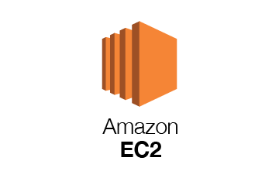
Release Management
Build Process
Check out
Run Unit Test
Run Code Scans
Build Final Artefact
Release Process
Config Changes
Security Credentials
Certificate Installations
Commits
Boot Process
Service Discovery Servers
Services Shell Scripts
Publish Process ID
Maintain Parity in all deployment environments
Build Release and Run process should work on all environments

Slide 15

monitoring solutions
Monitoring Solutions
AWS CloudWatch
Actuator Spring Boot
Alert Bot
Kubernetes container orchestration

Slide 16
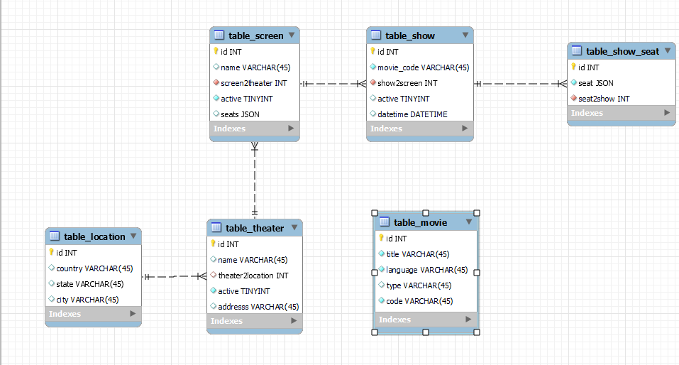
DATABASE DESIGN

Slide 17
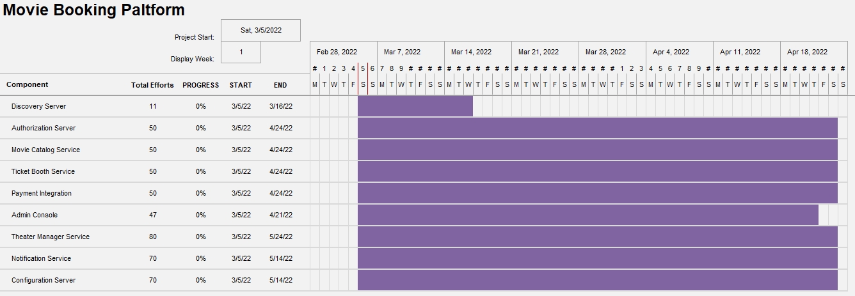
high level estimation

Slide 18

Thank you
GITHUB URL FOR CODE AND ARTEFACTS

